Slide 1

Smoke Alarm Blitz Briefing
Your Organization’s Name Here

Slide 2
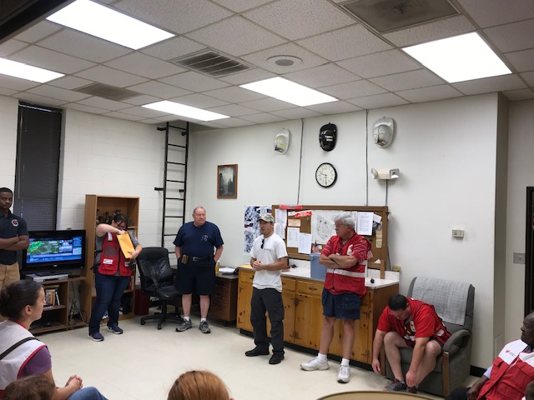
Smoke Alarm Blitz Briefing
Welcome and introduction
Roll call, team assignments and tasking
Schedule for the day
Accountability:
  Contact the command post BEFORE you approach each residence.
  Contact the command post AFTER you leave each residence.
  Provide a spot report that communicates the result of the visit.
Notes:
Welcome the participants, introduce yourself. Thank the participants for the difference that they will make today.
Call roll by making team assignments and giving tasking orders. Tasking orders should include a list of addresses that the team is assigned to visit.
Share the schedule of the day… what time is lunch? What time are all groups to report back to the CP to end the day?
Discuss accountability / communication: If anyone experiences any problems, they should contact the CP immediately.

Slide 3
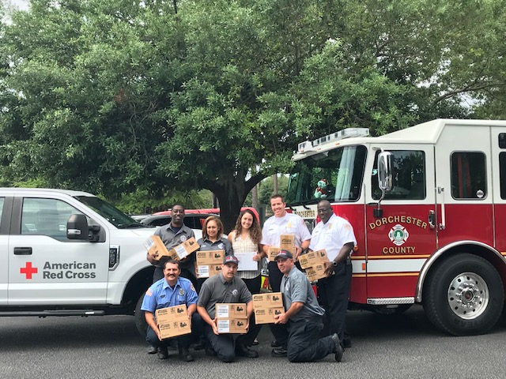
Smoke Alarm Blitz Briefing
Review the Core Four Safety Messages.
  Right Alarm – Right Location
  Fire Drills Plans and Prep
  Fire Sprinklers Save Lives
  See A Problem – Take Action
Documentation
Safety
Logistics and resources
Questions?
Notes:
Review the Core Four Safety Messages. Use slides from the HSV Training if needed for review.
Documentation – remind everyone how to complete the forms
Safety – talk about the weather, accountability, contact the CP if there are any problems, report injuries, wear seatbelts and safety vests, never go in a home or a room of a home alone,

Slide 4
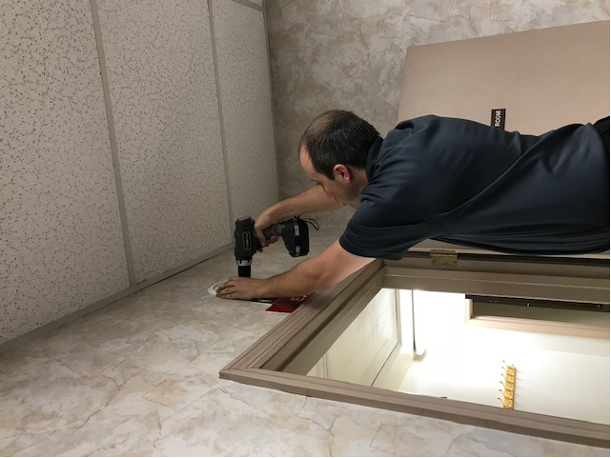
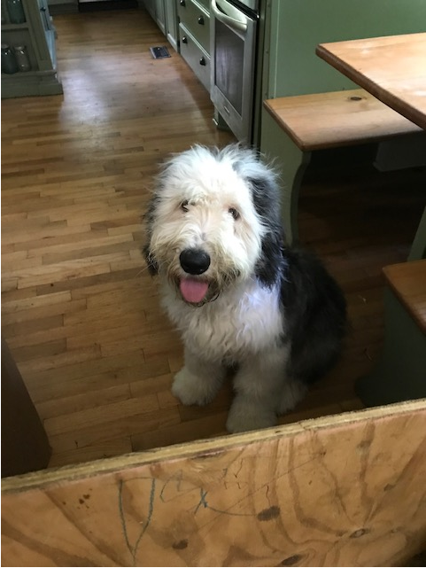
Tips to Ensure Success
Do not approach homes with signs that read “No Trespassing” or “No Soliciting.” Avoid homes that have warning signs about aggressive dogs or where dogs cannot be safely secured.
Always stay within eyesight of your team and never enter or leave a home without everyone accounted for.
Before knocking on the door, report to your command post the address of your location.

Slide 5
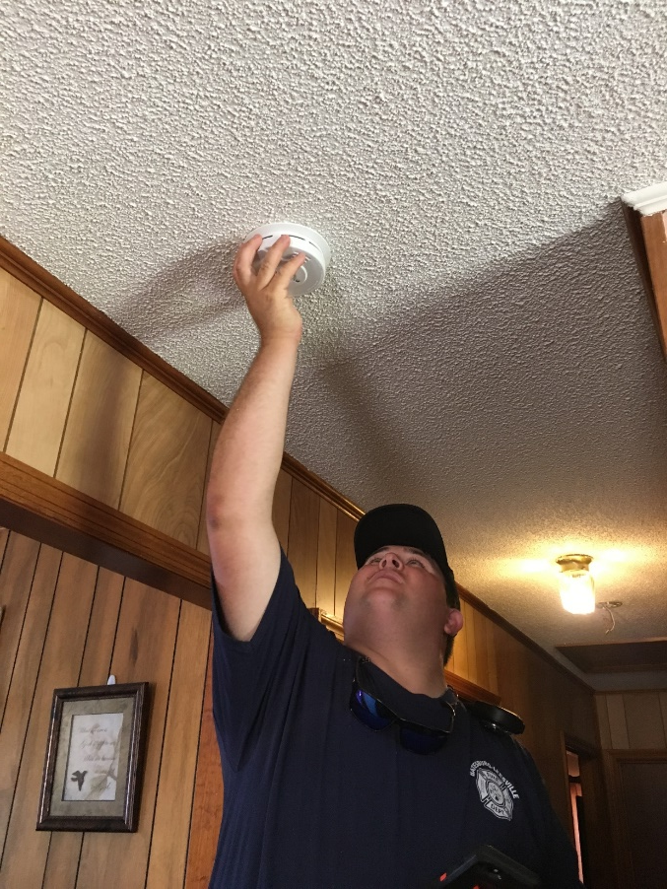
Tips to Ensure Success
After knocking on a door or ringing a doorbell, take several steps back and wait no more than two minutes for an answer.
If the resident answers, politely introduce yourself and your fellow team members before describing the services that your team is there to offer on behalf of the Red Cross and our partners, including free alarm installations and replacement batteries, as well as life-saving safety information.
Notes:
Other tips to add….
3 knock rule
Do not ask the resident for something to eat or drink.
Do not use the resident’s bathroom.

Slide 6
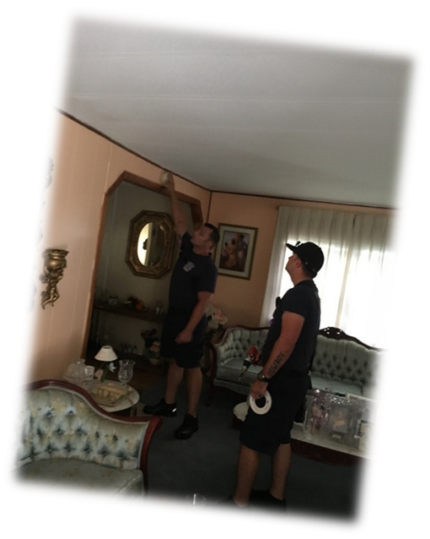
Tips to Ensure Success
Before entering a home, always get permission from an adult (18+) resident. Do not enter a residence if children are home alone or if an adult resident is not present.
Use the buddy system inside of the home. Individual volunteers should never be left alone in a room or with a resident.

Slide 7
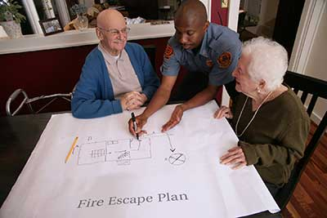
Tips to Ensure Success
When you complete the Home Safety Visit, contact the Command Post to let me know you are leaving that home. Report the number of alarms installed and other information that the IC may require.
If ever you feel that you or your team are in danger, move to a safe location and call 9-1-1. Follow instructions from the dispatcher. Contact the command post to advise them of the situation.

Slide 8


Documentation Matters
FIRE SAFE SC uses the American Red Cross Partner Direct
Service Acknowledgement Form and
Fire Alarm Installation Database.
Notes:
There are multiple benefits that include:
Centralized reporting
Reduced duplication of effort in reporting
Improved quality of data being captured
Lowered cost for database development, tracking, and accountability
Strengthened relationships with our stakeholders

Slide 9
Documentation Matters
Complete one “Partner Direct Service Acknowledgement Form” for each home entered.
  Complete even if no alarms were installed.
This form allows us to document all of the activities that occur during your visit.

Slide 10
Documentation Matters
Complete as much of the form as is applicable.
All fields with an asterisk (*) must be completed.
Be sure to include your FDID.
Make sure you log number of installed CO’s in “Option 2” block on form
Notes:
FDID will already be completed on Red Cross forms received from Fire Safe SC

Slide 11
Documentation Matters
Completed forms should be sent to FireSafeSC@llr.sc.gov we will submit to Red Cross on your behalf

Slide 12
Smoke Alarm Blitz Briefing
Your Organization’s Name Here

